Slide 1
DESIGN OF A SMART FIRE DETECTION SYSTEM
DAVID GOSLEE, ISRAEL AKINSOYINU, DEDRICK MCCOY

Slide 2
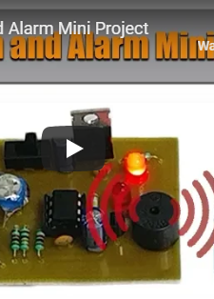
PROJECT INSPIRATION
This was a mini fire detection system found on Nevon Projects.
Detects a fire using a thermistor.
Simple LED and alarm notification.
A good base line device but leaves a lot to be desired.

Slide 3
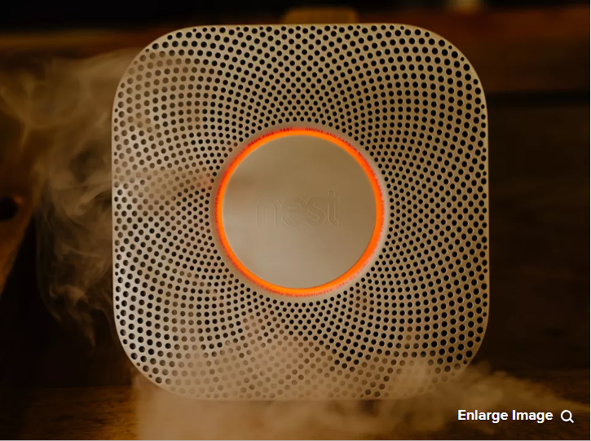
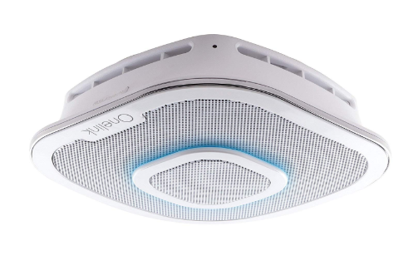
NEST SMART DETECTOR
ALEXA ENABLED SMOKE DETECTOR AND CO MONITOR
This is the Nest Project smart fire detector.
Uses a photoelectric sensor and a split-spectrum sensor to detect possible fire threats.
Is equipped with its own app that alerts users when an issue arises.
Can be deactivated via app interface if there is a false alarm.
Prices range from 50 through 180 dollars
This is another product that is similar in nature to the project we envision.
Uses photoelectric sensors to detect possible fires.
Comes equipped with a Carbon Monoxide monitoring system.
Compatible with all apple products.
Alexa enabled and uses First Alert OneLink app to notify users.
Prices range from 200 – 270 dollars.

Slide 4
SMART FIRE DETECTION SYSTEM OBJECTIVES
The project goal is to create a smart fire detection system that can be implemented for commercial and in home use that will determine the fire location i.e. room, floor, or stair well and notify dispatch operators and alert building occupants.

Slide 5
DESIGN REQUIREMENTS
911 call that notifies dispatch of a potential fire and its location within the building.
Detect the temperature of the fire (for flash point).
Monitor Carbon Monoxide levels.
Sms warning message for building occupants.
Must provide output signals for PPE systems (i.e. sprinklers, automatic doors, etc.).
Fire Detector should mount to existing detectors base mount.
Website will display node location on building floor plan.
Threat location will be highlighted and displayed on the websites building floor plan.

Slide 6
Design Constraints
Voice alarm notification for occupants of structure.
Wireless nodes must be no more than 60 feet apart.
The manufacturing of one node should not exceed a budget of 150 dollars.

Slide 7
National Industrial Standards
The initiation function provides the input signal to the system (NFPA 101, 9.6.1.7).
The notification function is the means by which the system advises that human action is required in response to a particular condition (NFPA 101, 9.6.1.7).
The control function provides outputs to control building equipment to enhance protection of life (NFPA 101, 9.6.1.7).
Occupant notification shall be by means of voice announcements (NFPA 101, 12.3.4).
Fire alarm circuits shall be installed in a neat workmanlike manner (NFPA 70 Art. 760.24).
Cables and conductors installed exposed on the surface of ceilings and sidewalls shall be supported by the building structure in such a manner that the cable will not be damaged by normal building use (NFPA 70 Art. 760.24).
Smoke detector must be replaced every ten years in accordance to Maryland Smoke Alarm Law.
The smoke alarm requirements for existing older homes are based upon when the house was built.
The Law heavily emphasises the use of sealed smoke alarms with long life batteries and silence/hush buttons.
Any new home in Maryland constructed after January 1, 1989 required at least one hardwired electric smoke alarm on every level of the home, including the basement.
The units must be interconnected in order that activation of any one of the required smoke alarms resulted in the sounding all of the required smoke alarms.
The time from the detector’s issuing a fire alarm signal to the controller’s receiving should be controlled within the 10 seconds (GB4717-2005 Fire Alarm Control Units)
The time from the detector’s issuing a fire alarm signal to the controller’s receiving should be controlled within the 10 seconds (GB4717-2005 Fire Alarm Control Units)

Slide 8
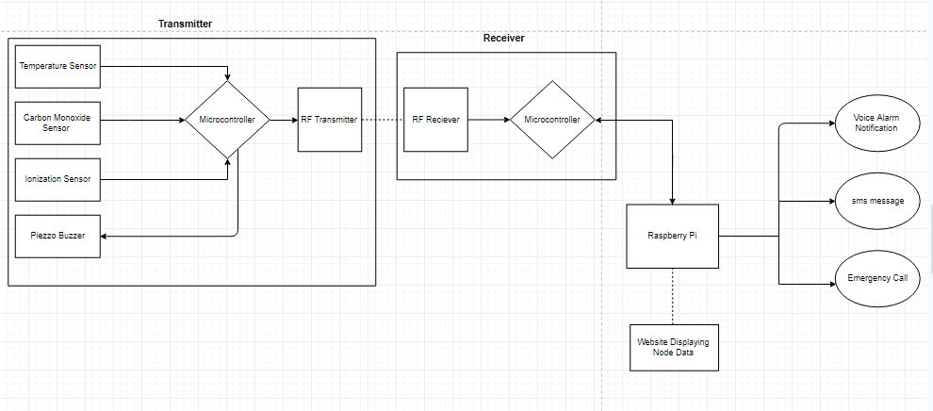
System Diagram

Slide 9
Implementation Plan
Task 1: Sensor Design
1.1: Design program for Temperature Sensor.
1.2: Design program for Carbon monoxide sensor.
1.3: Design program for Ionization sensor.
1.4: Configure arduino with all three sensors.
1.5: Design PCB for transmitter.
1.6: Design PCB for receiver.
1.7: Design program and configure Motion Sensor.
Task 2: Wireless Sensor Network Design
2.1: Configure arduino and RF transmitter.
2.2: Program arduino and RF transmitter.
2.3 Configure arduino and RF receiver interface.
2.4: Program interface with arduino and RF receiver.
2.5: Configure all sensors with RF receiver and transmitter.
2.6: Configure Raspberry Pi with RF receiver.
2.7: Configure raspberry pi to retrieve and display node data.
2.8: Design program that will interpret and store node data.
2.9: Design voice alarm notification platform for building occupants.

Slide 10
Implementation Plan (continued)
Task 3: Website Design
3.1: Design background and layout of website.
3.2: Design login for administrator and user access.
3.3: Program a drag-and-drop to assign each node ID to each room in the building.
3.4: Design a program that will interface raspberry pi and website.
3.5: Design a program that will pair node ID with corresponding room on the building layout.
Task 4: Configure raspberry pi and website
4.1: Design program that will transmit and display WSN data on webpage.
4.2: Design program that will display warning messages from pi on webpage.
4.3: Program administrative link for admin upload of floor plan.
4.4: Configure node IDs with building layout.
4.5 Program alarm system shut off for administrative use.
4.6 Program website to receive and notify administrator when motion detector is tripped.
Task 5: Automated Phone Call System Design
5.1: Setup TWILIO account and install software on raspberry pi.
5.2: Configure TWILIO with wireless sensor network.
5.3: Design Virtual Alert message for each specific node ID.
5.4: Design program that will allocate node ID numbers to specific automated dispatch message (local).
5.5: Program each specific node ID for a specific SMS message transmission.

Slide 11
Implementation Plan (cont.)
Task 6: Design SMS Warning Message Database
6.1: Design database that will contain building occupant phone numbers (Cloud).
6.2: Configure database with SMS message warning protocol (Cloud).
6.3: Design a program that will send building occupants a link to webpage.
Task 7: Design 3D printed housingings for transmitter and receiver modules.
Design cad model for transmitter housing.
Design cad model for receiver housing.
Print transmitter and receiver housings.
Task 8: System Assembly and Testing
8.1: Assemble entire system.
8.2: Test full platform with nodes placed in their appropriate positions.
8.3: Test warning systems and ensure they give proper threat location.

Slide 12
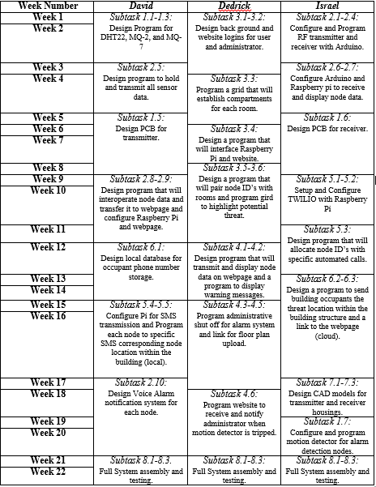
Implementation Timeline

Slide 13
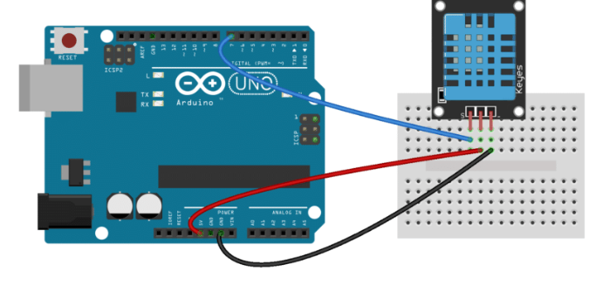
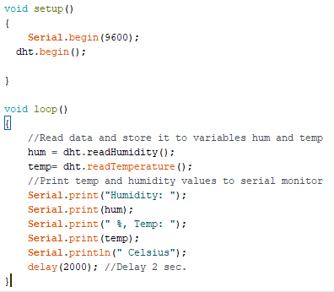
Implementation (Subtask 1.1) Circuit Design and program for DHT22 temperature Sensor.

Slide 14
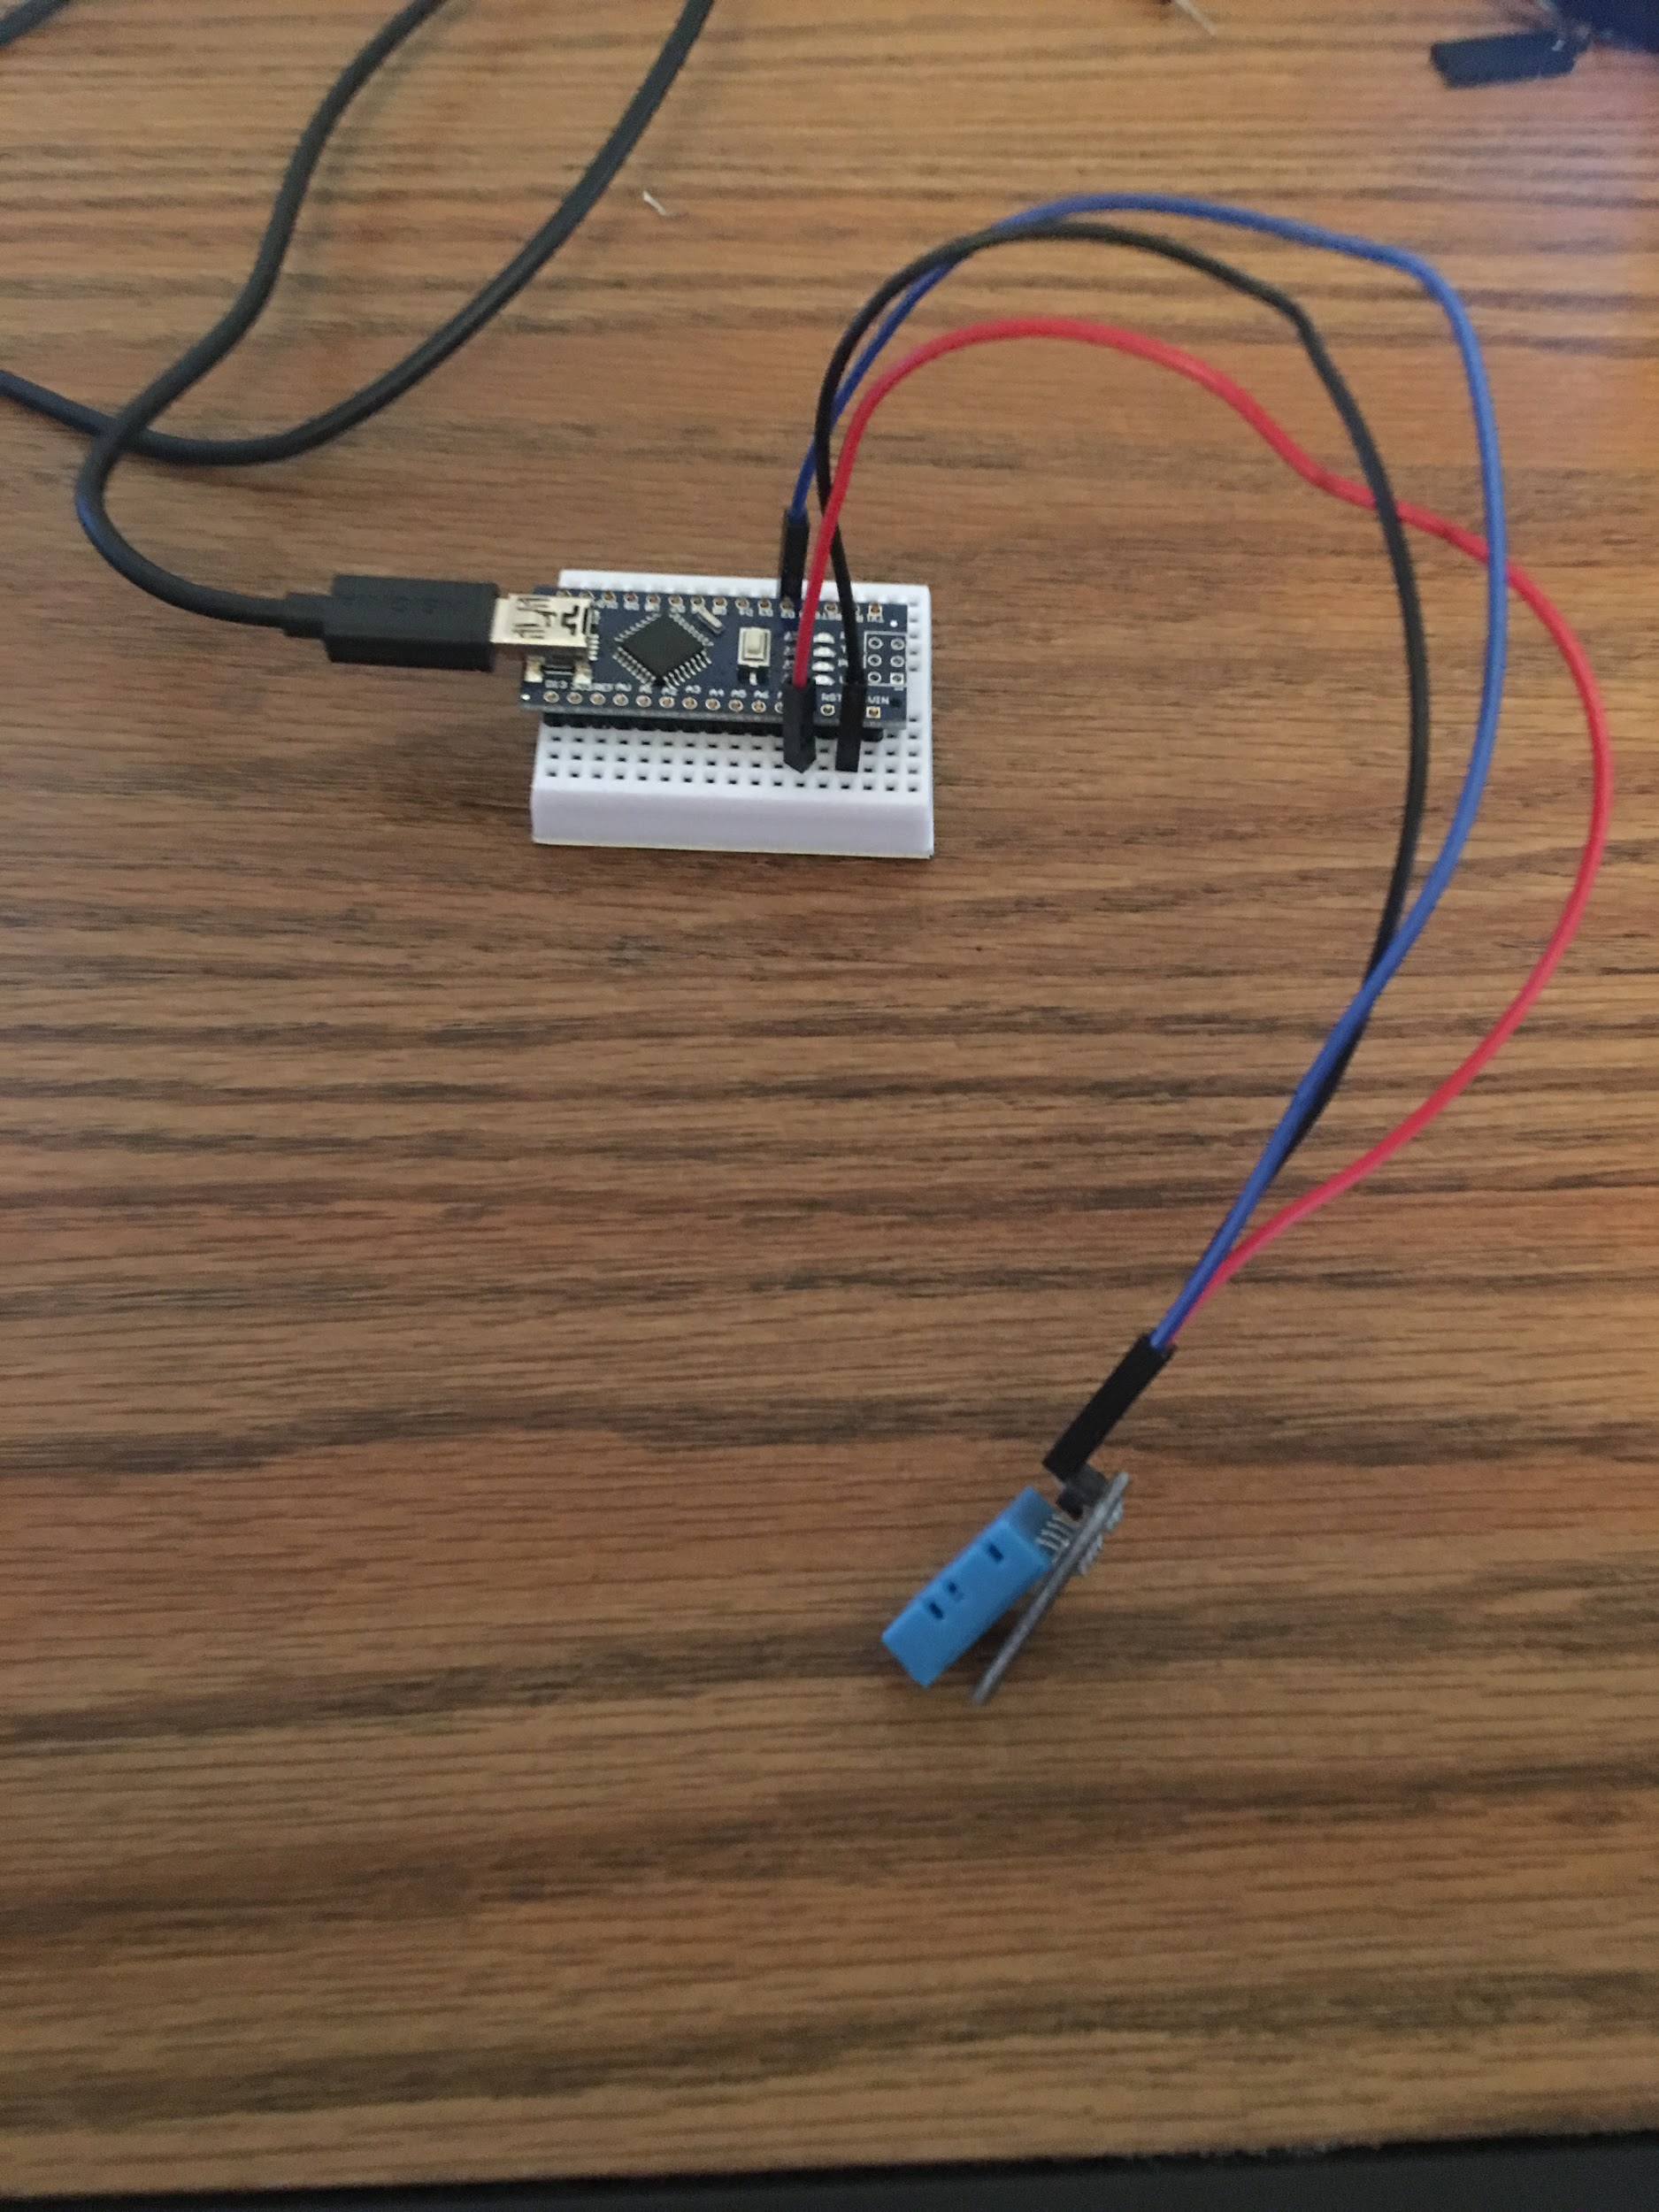
Implementation (Subtask 1.1) Circuit Design and program for DHT22 temperature Sensor.

Slide 15
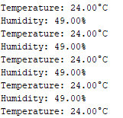
Implementation (Subtask 1.1) Circuit Design and program for DHT22 temperature Sensor output.
Output displays both temperature and humidity.
Only temperature is sent to the RF transmitter.

Slide 16
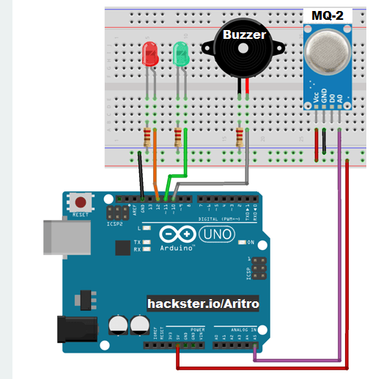
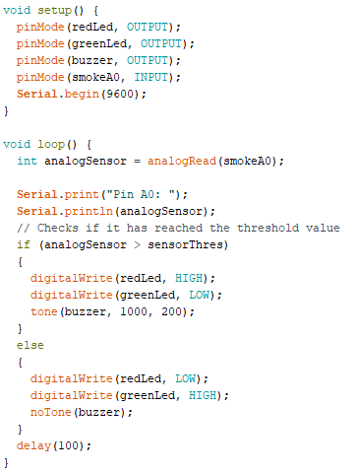
Implementation (Subtask 1.2) Design circuit and program for MQ-2 ionization sensor

Slide 17
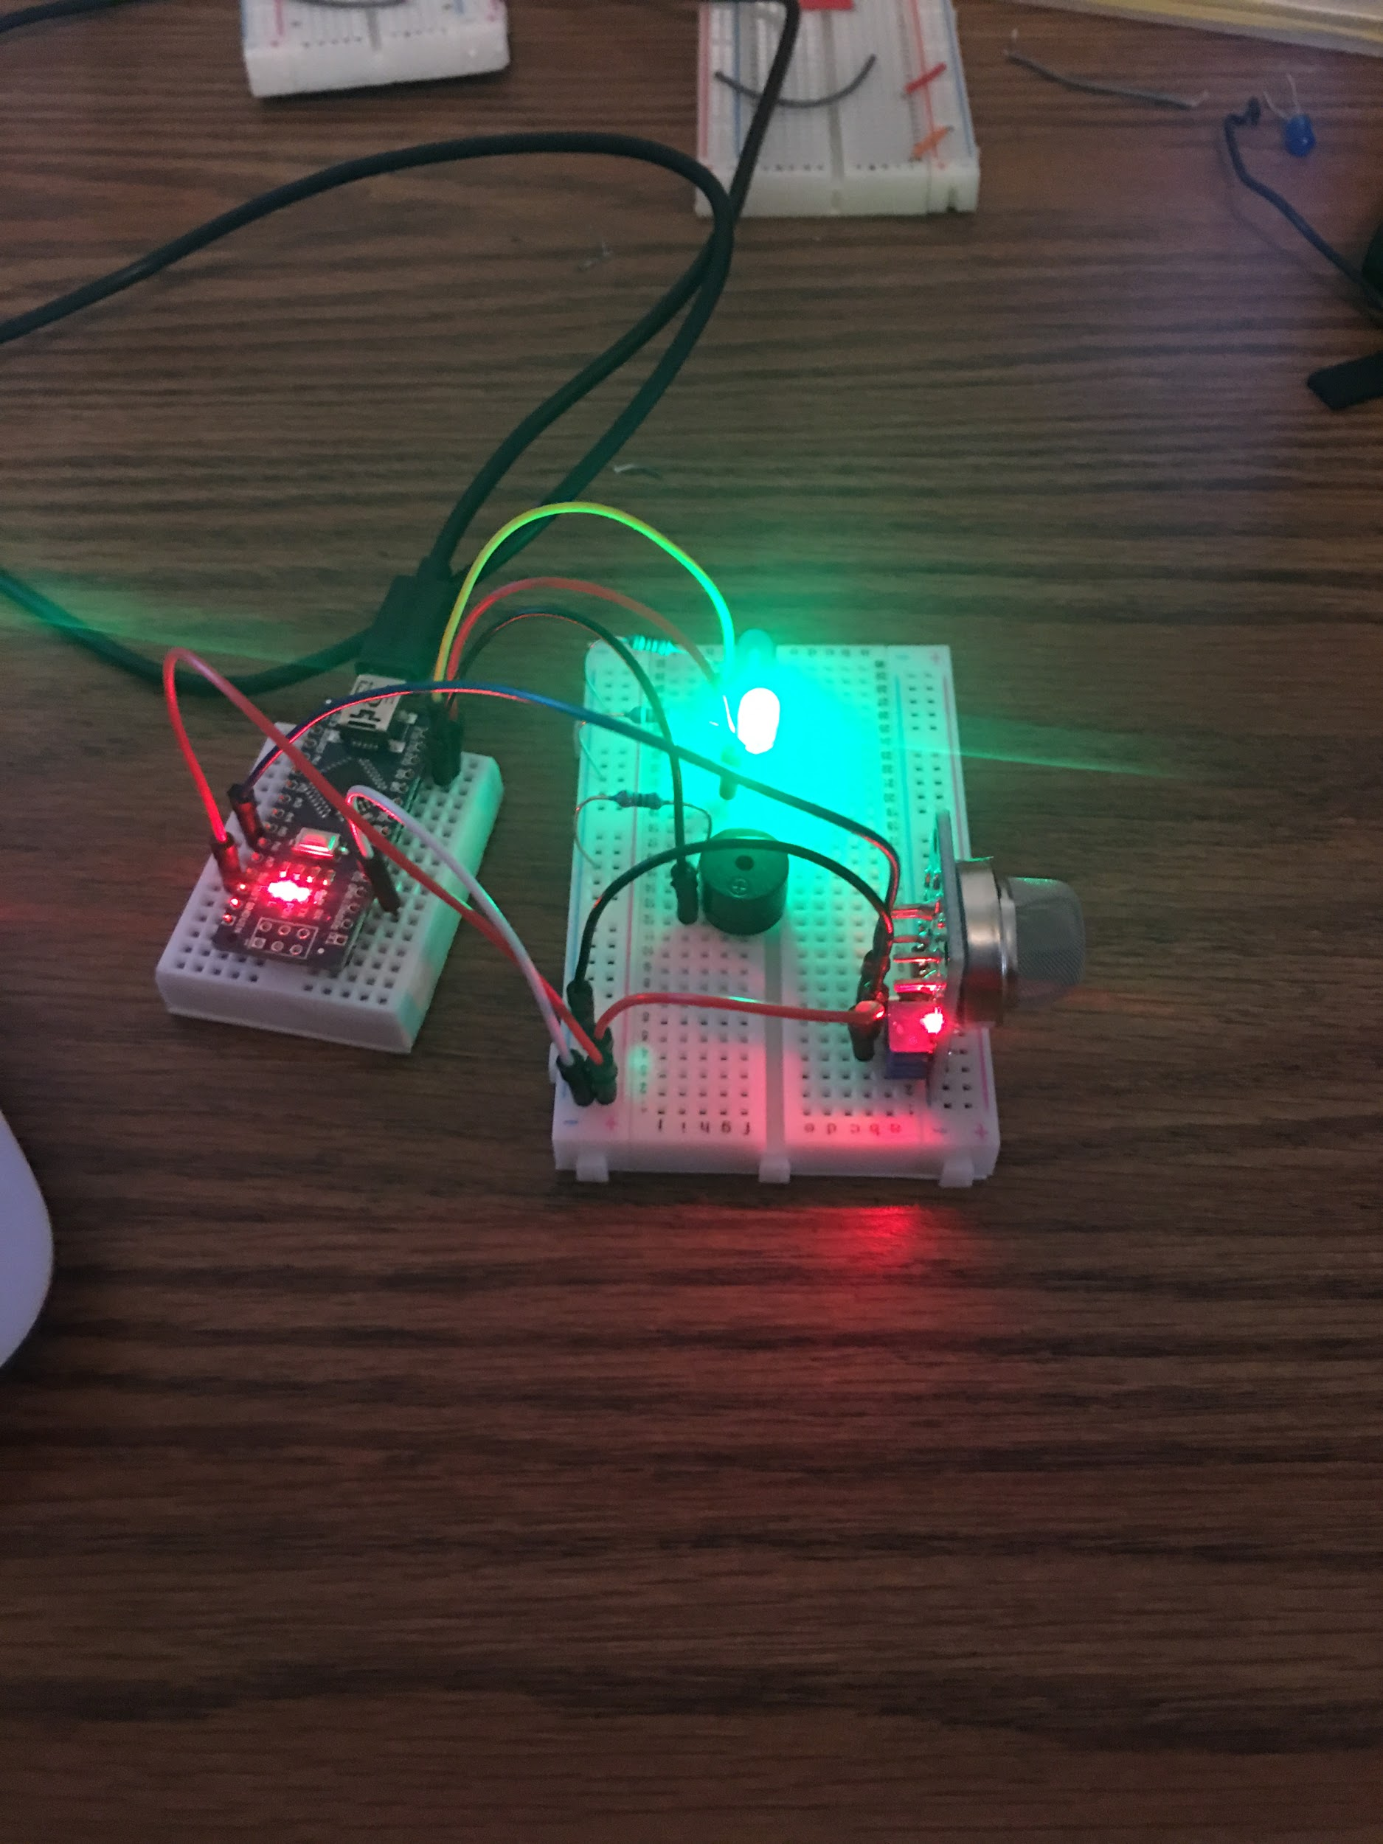
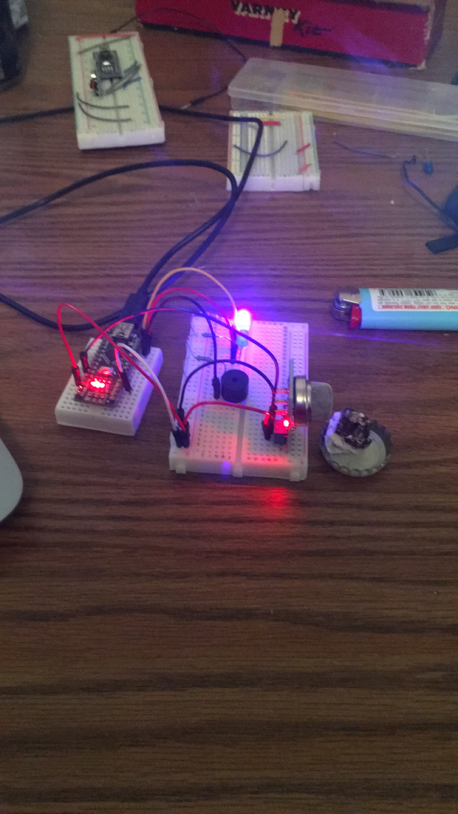
Implementation (Subtask 1.2) Design circuit and program for MQ-2 ionization sensor.

Slide 18
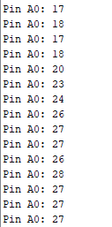
Implementation (Subtask 1.2) Design circuit and program for MQ-2 ionization sensor output.
Output is transmitted via analog pin 0.
Air particulate is measured in ppm (parts per million).
Threshold value set at 20 ppm.

Slide 19
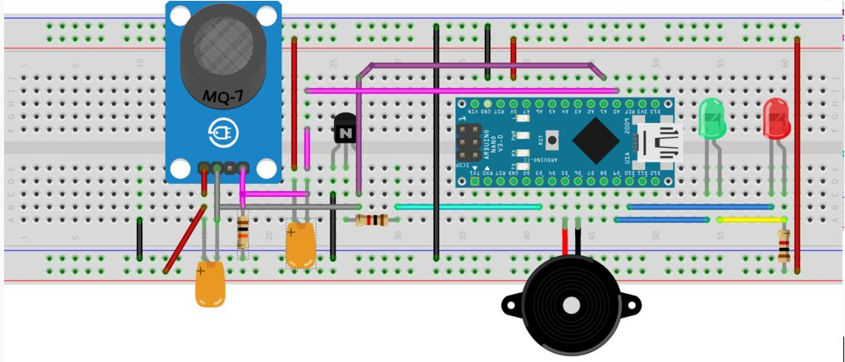
Implementation (Subtask 1.3) Design Circuit and program for MQ-7 CO sensor.

Slide 20
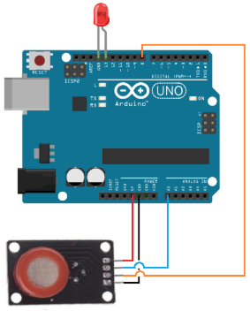
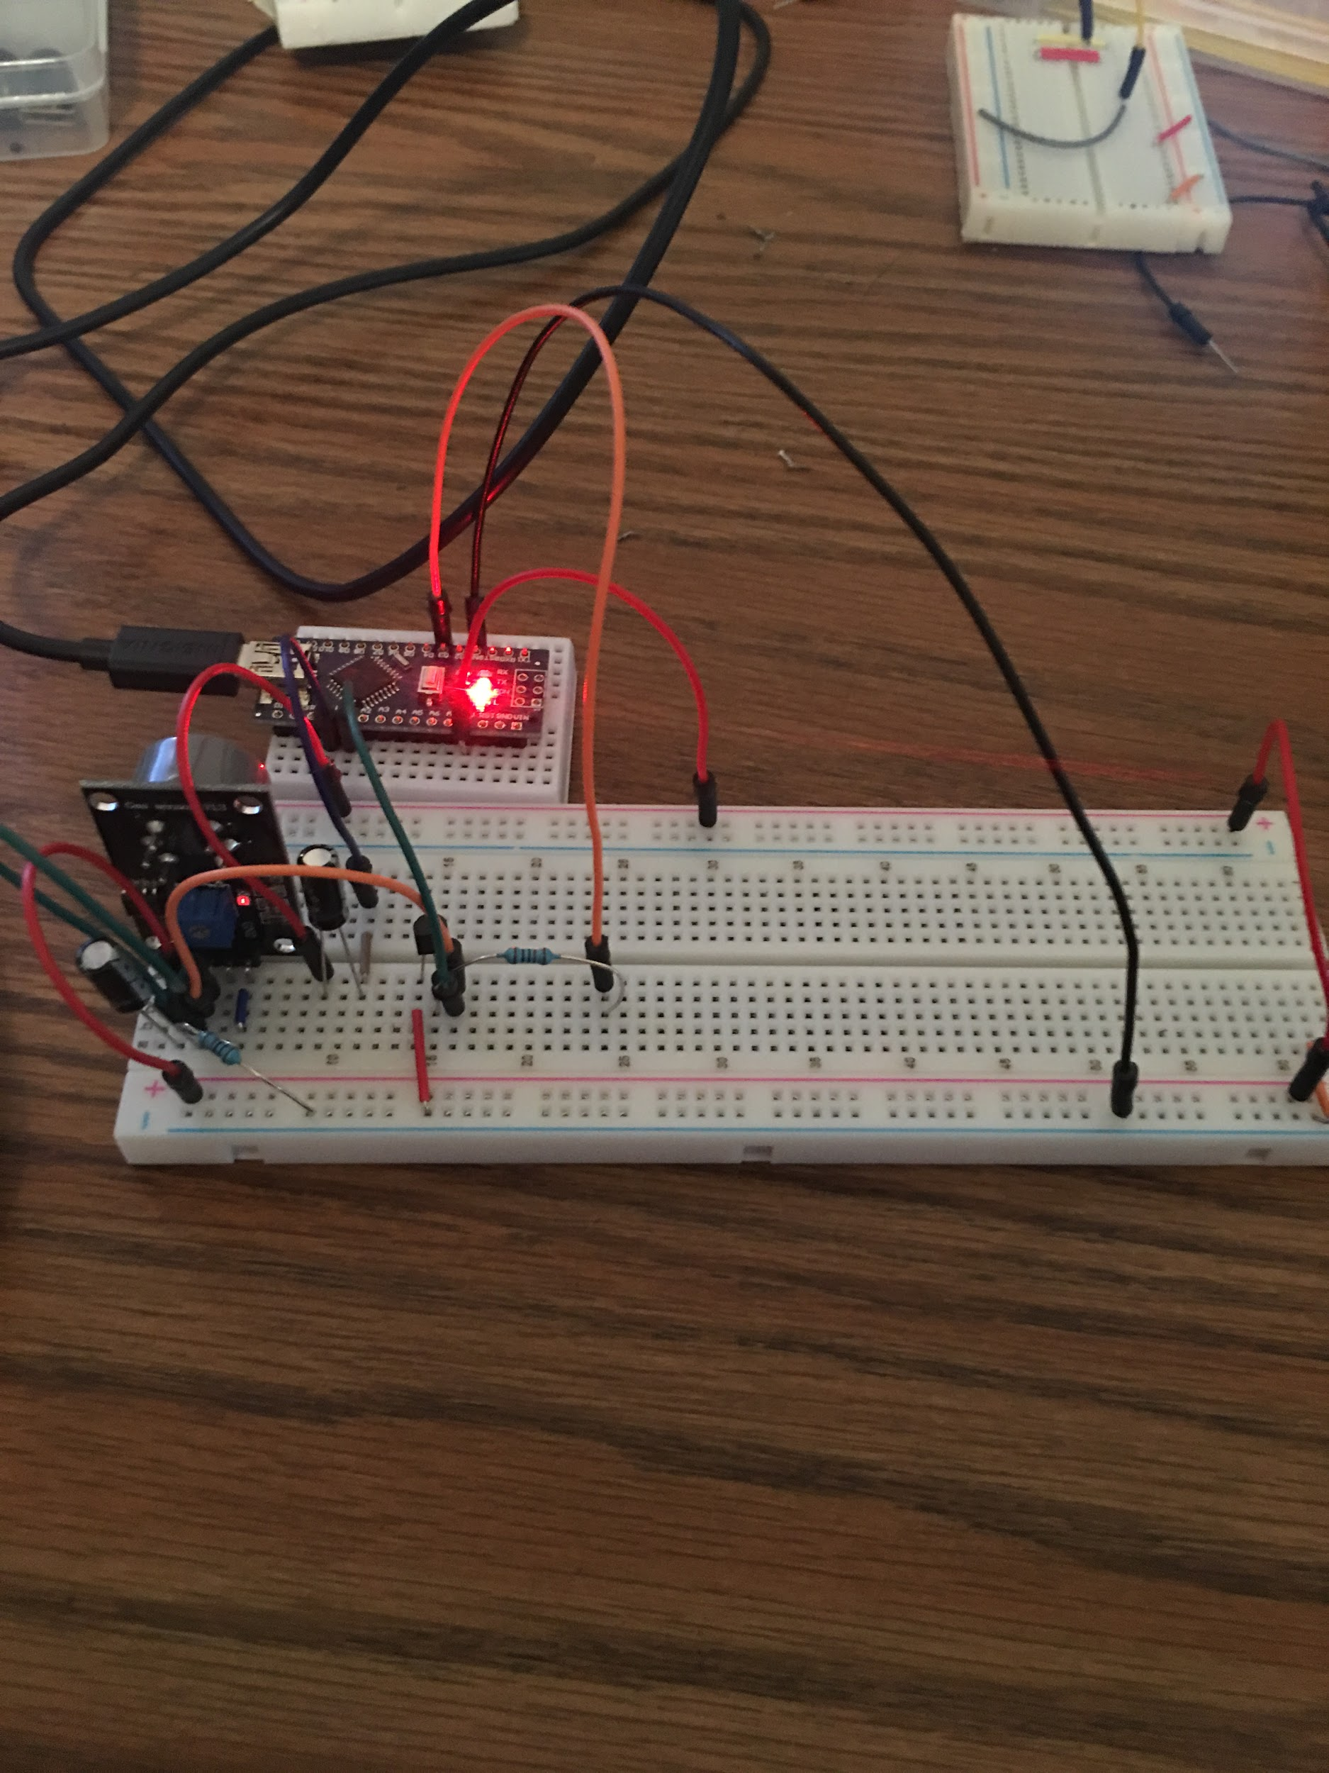
Implementation (Subtask 1.3) Design Circuit and program for MQ-7 CO sensor.

Slide 21
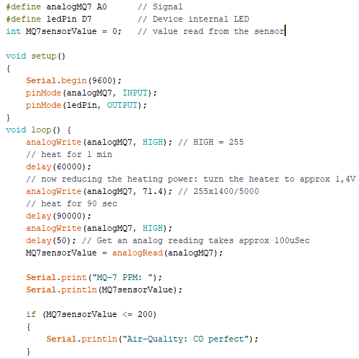
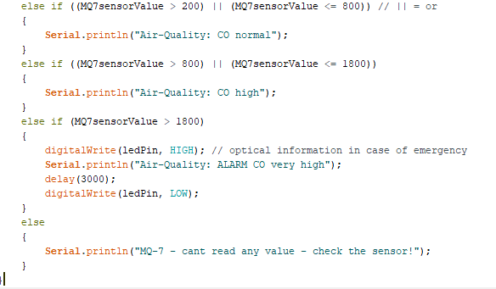
Implementation (Subtask 1.3) Design Circuit and program for MQ-7 CO sensor.

Slide 22
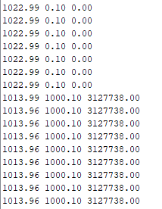
Implementation (Subtask 1.3) Design Circuit and program for MQ-7 CO sensor output.
CO threshold set to 1500 ppm.
Third column represents CO reading (ppm)

Slide 23
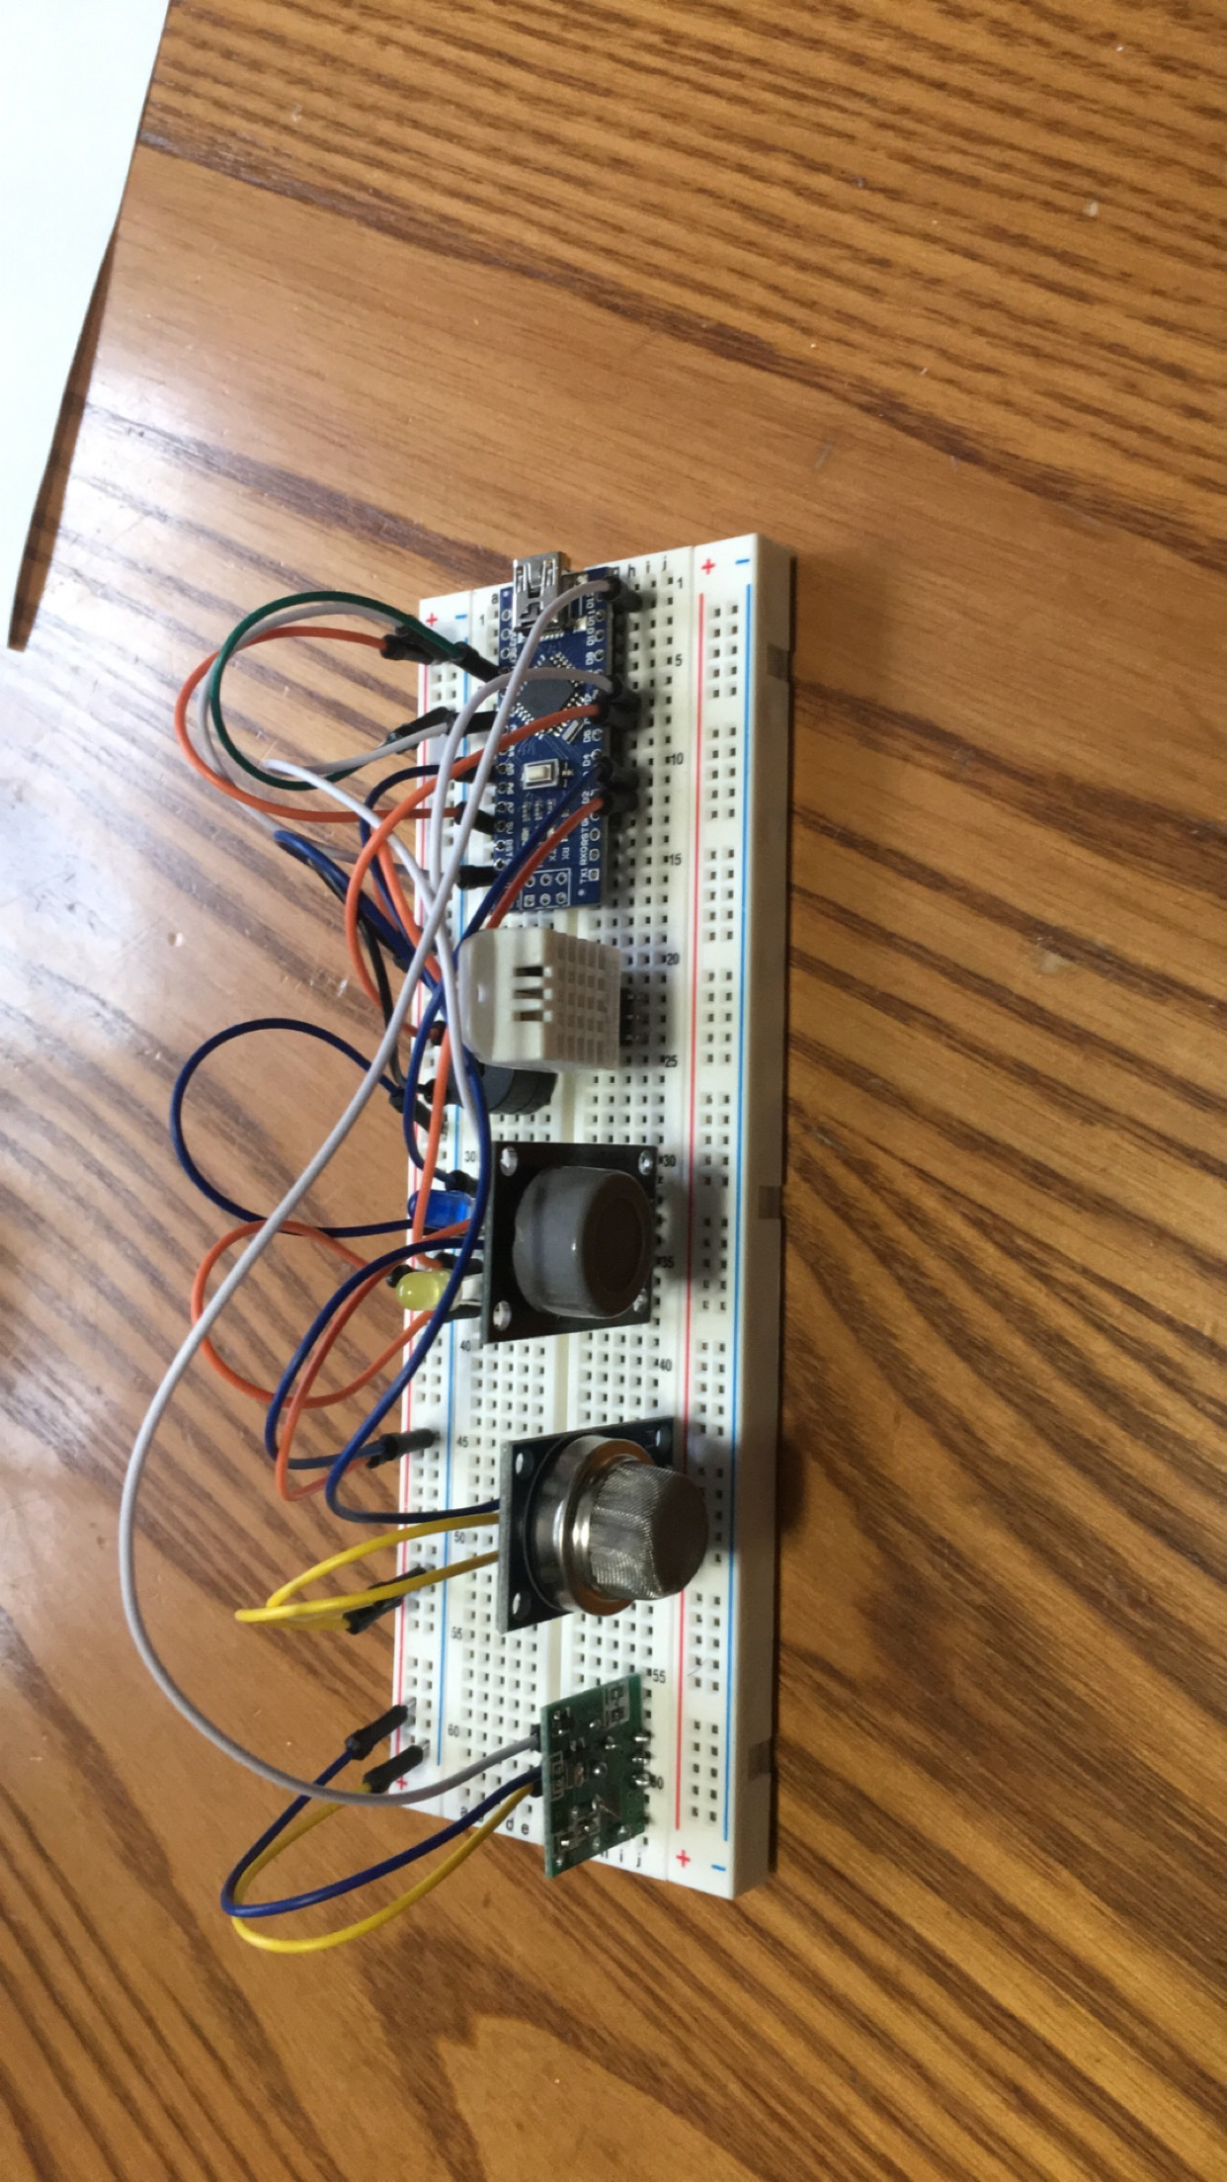
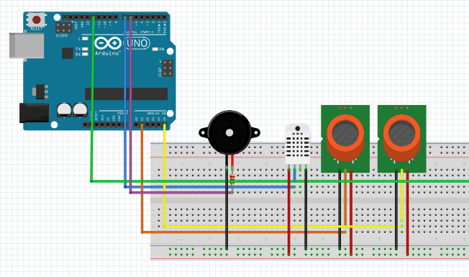
Implementation (subtask 1.4) Interface all sensors with arduino.

Slide 24
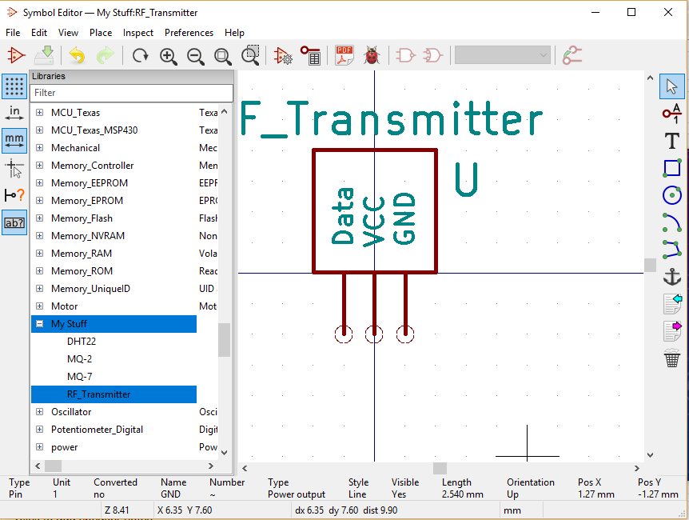
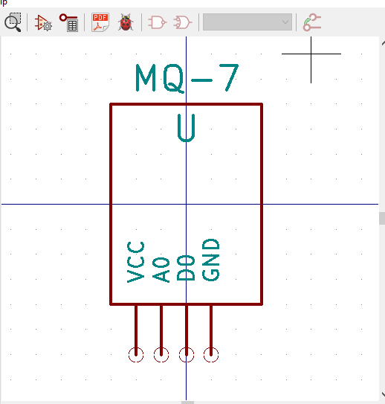
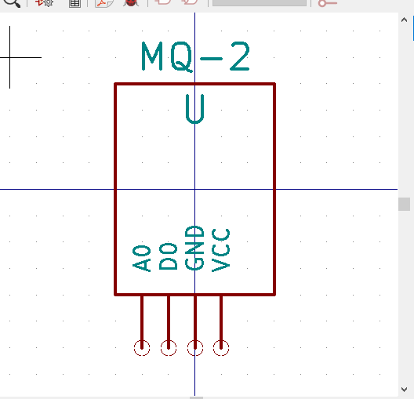
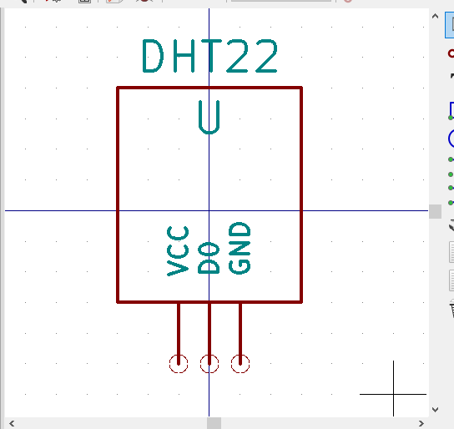
Implementation (subtask 1.5) Design PCB for transmitter.

Slide 25
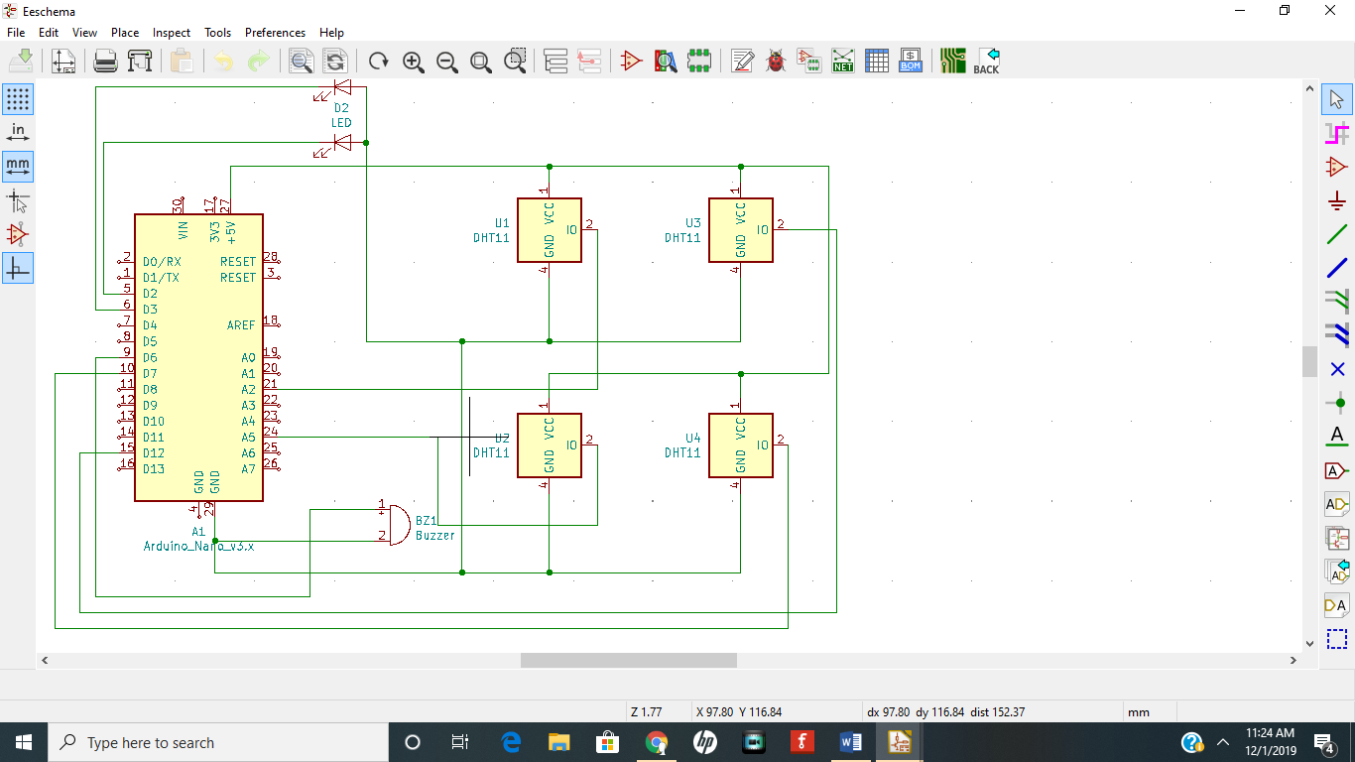
Implementation (subtask 1.5) Design PCB for transmitter.

Slide 26
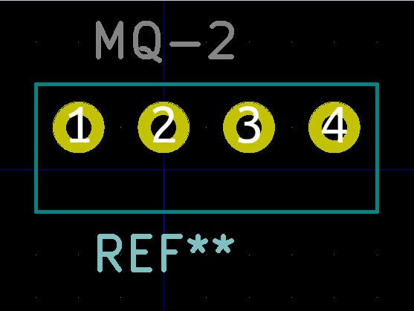
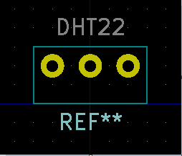
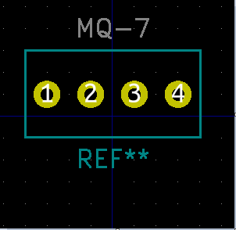
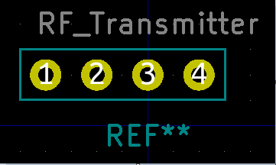
Implementation (subtask 1.5) Design PCB for transmitter.

Slide 27
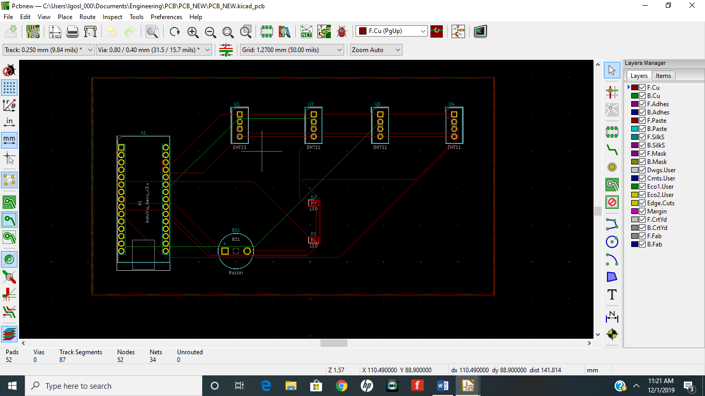
Implementation (subtask 1.5) Design PCB for transmitter.

Slide 28
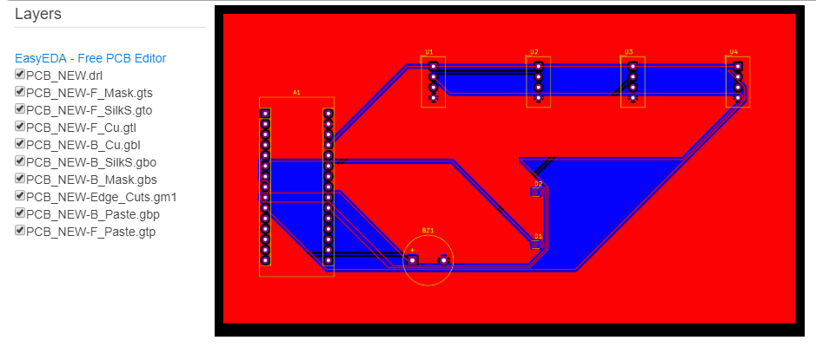
Implementation (subtask 1.5) Design PCB for transmitter continued.

Slide 29
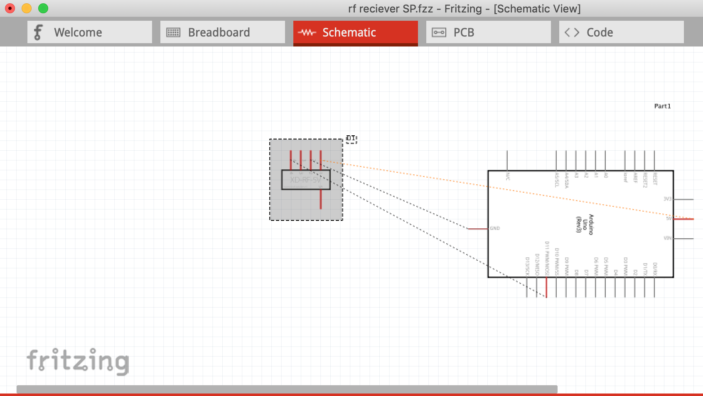
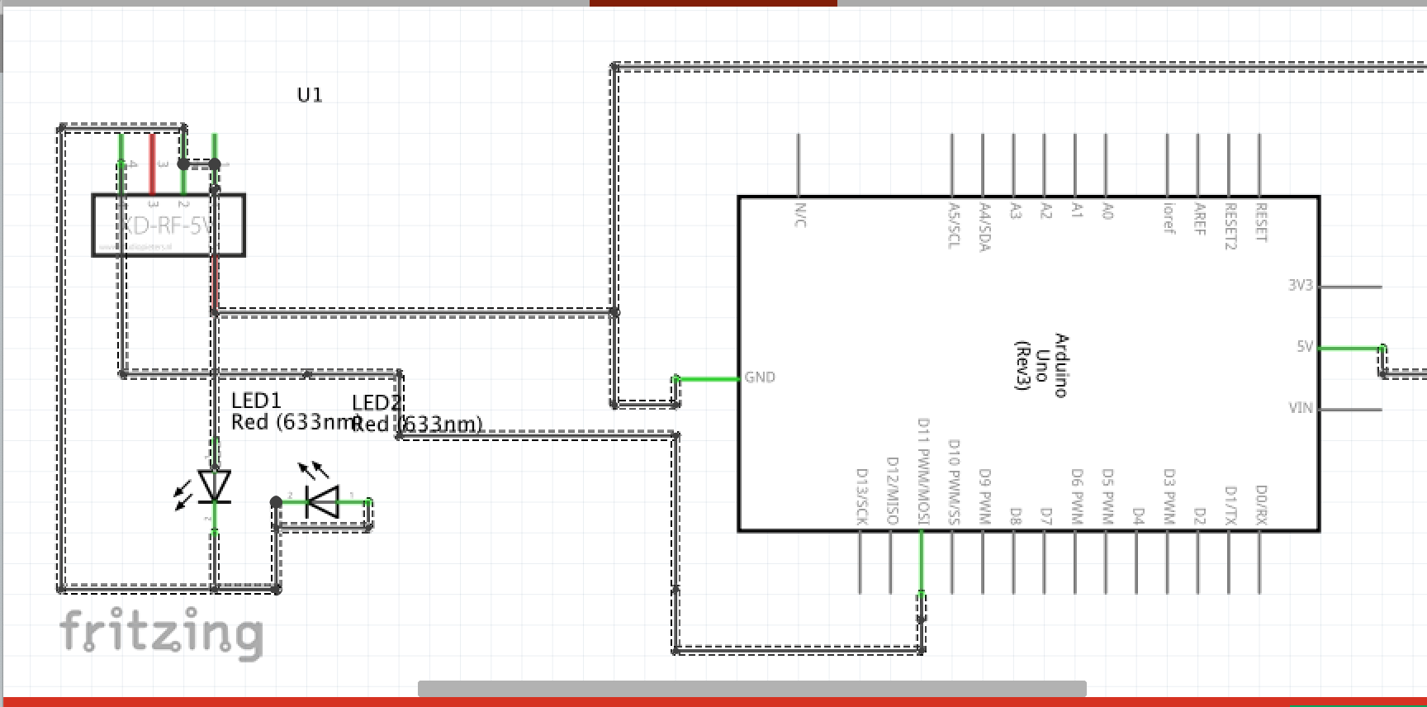
Implementation (subtask 1.6) Design Schematic for receiver.

Slide 30
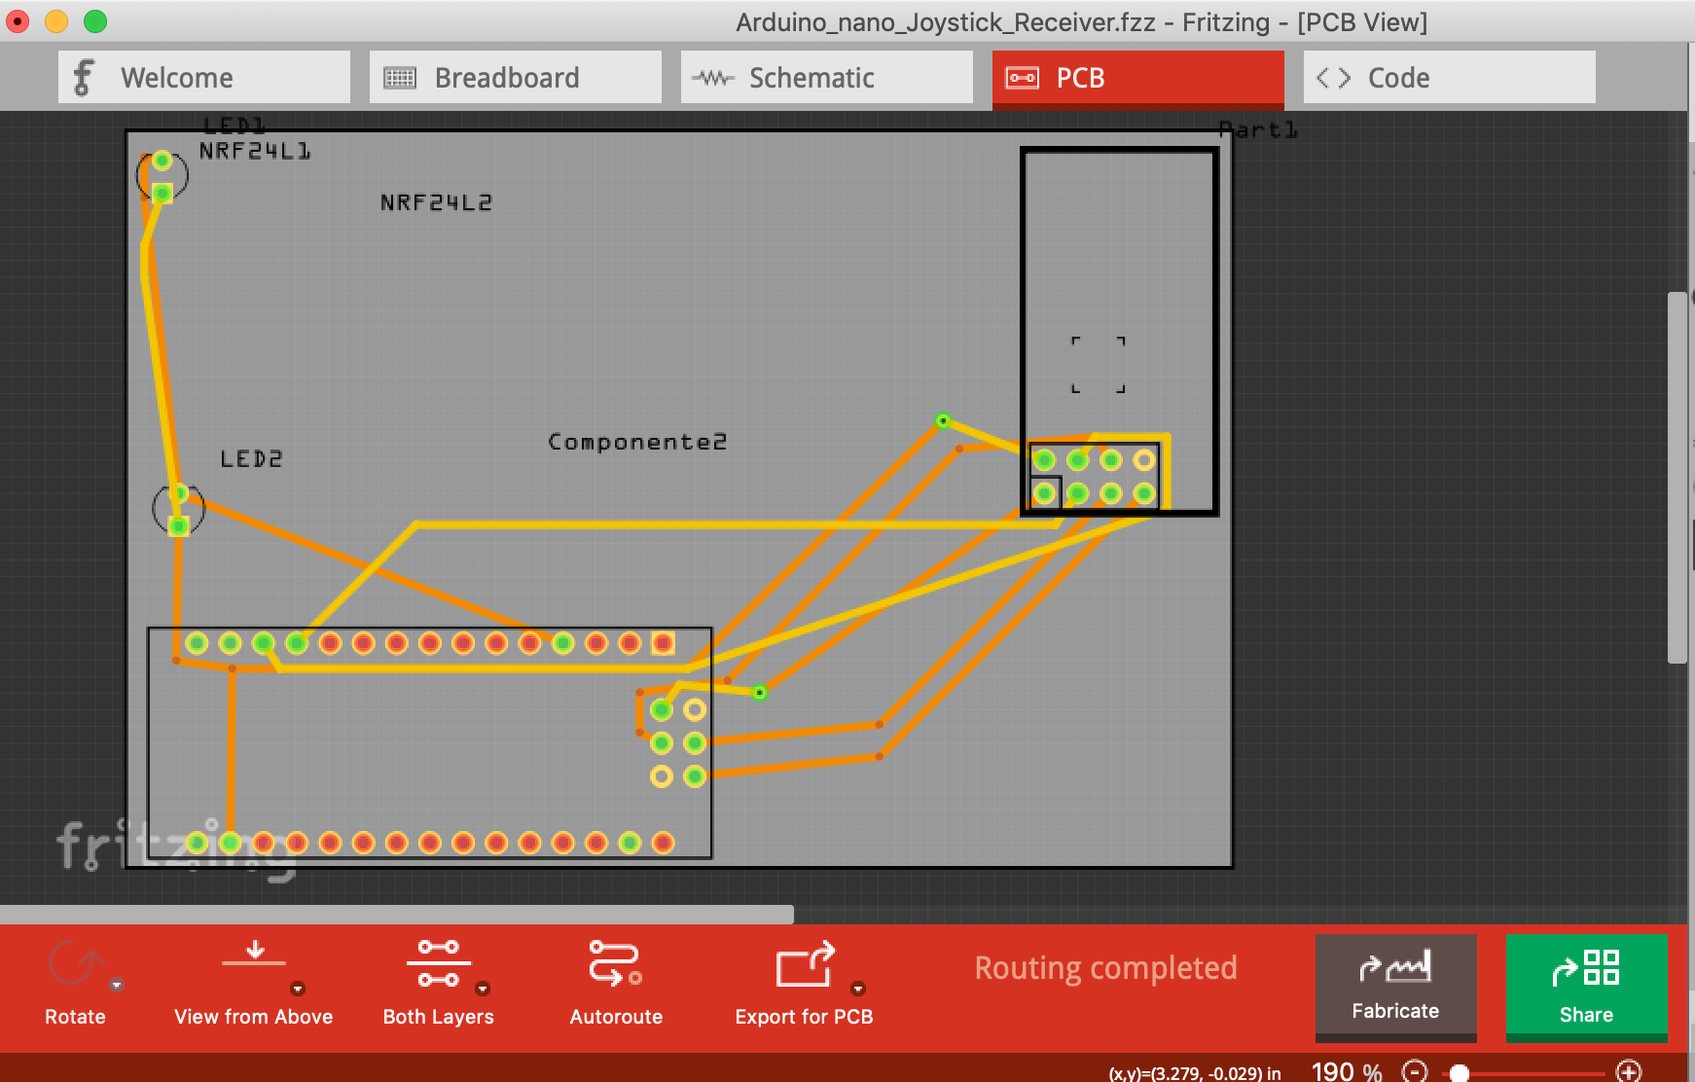
implementation (subtask 1.6) Design PCB for receiver.

Slide 31
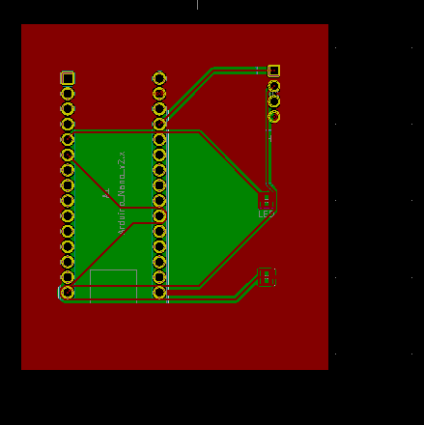
implementation (subtask 1.6) Design PCB for receiver.

Slide 32
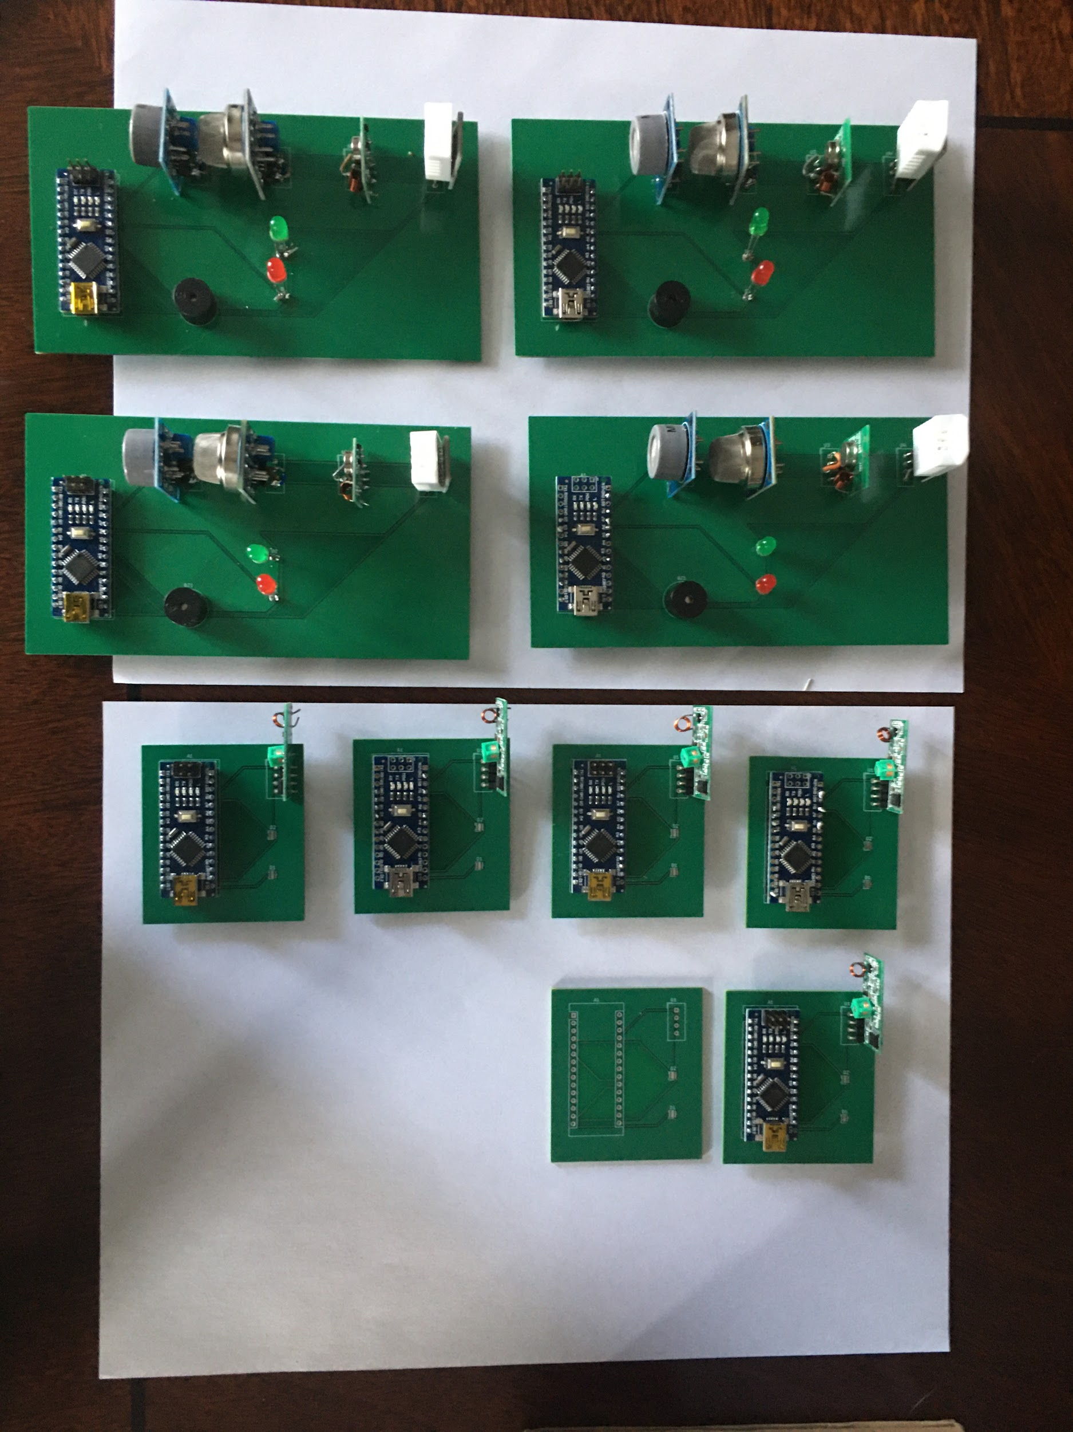
Implementation (subtask 1.5 and 1.6) Design PCB for transmitter and transmitter completed.

Slide 33
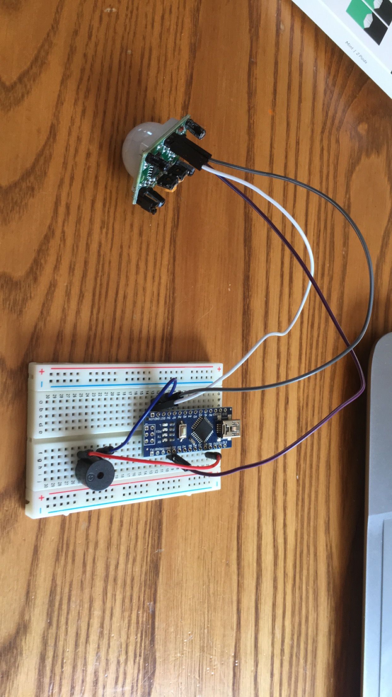
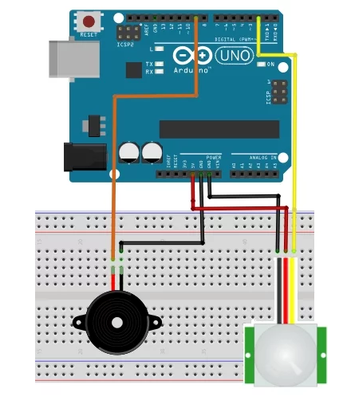
Implementation (subtask 1.7) Design program and configure motion detector.

Slide 34

Implementation (subtask 1.7) Design program and configure motion detector.

Slide 35
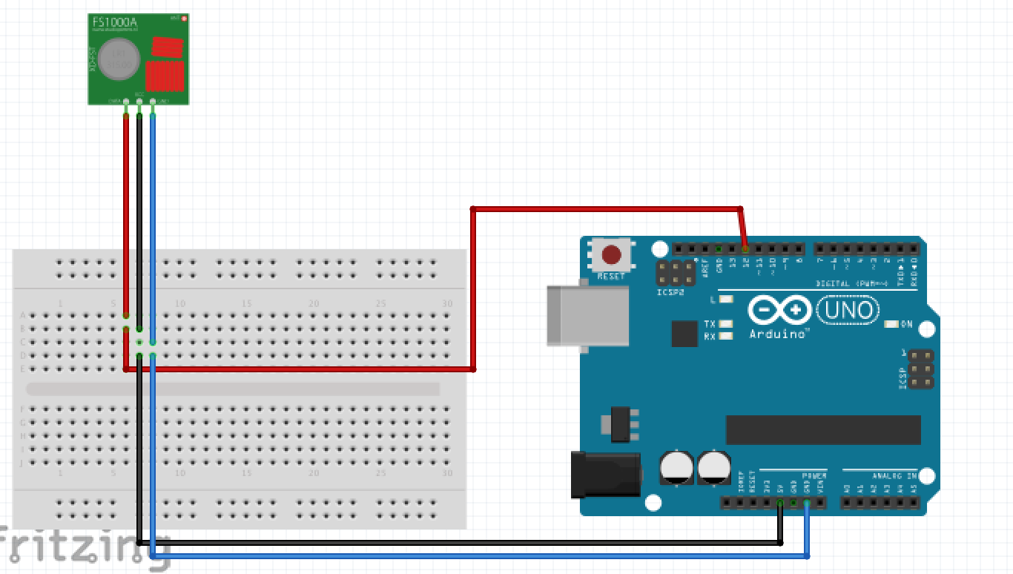
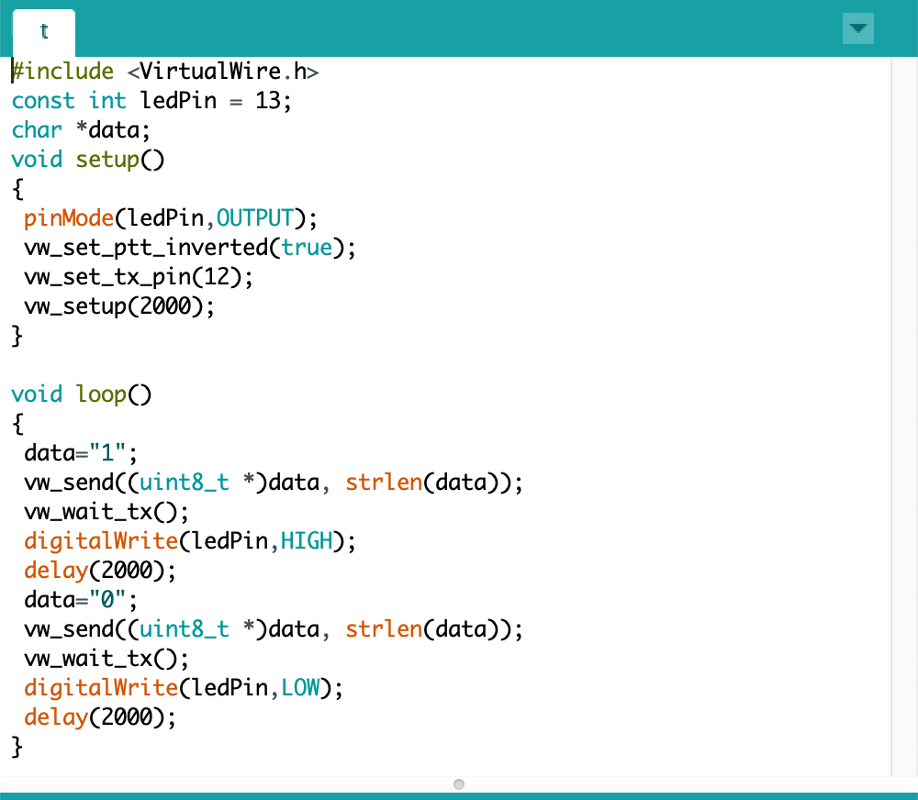
Implementation (subtask 2.1- 2.2) Design of arduino and RF transmitter interface.

Slide 36
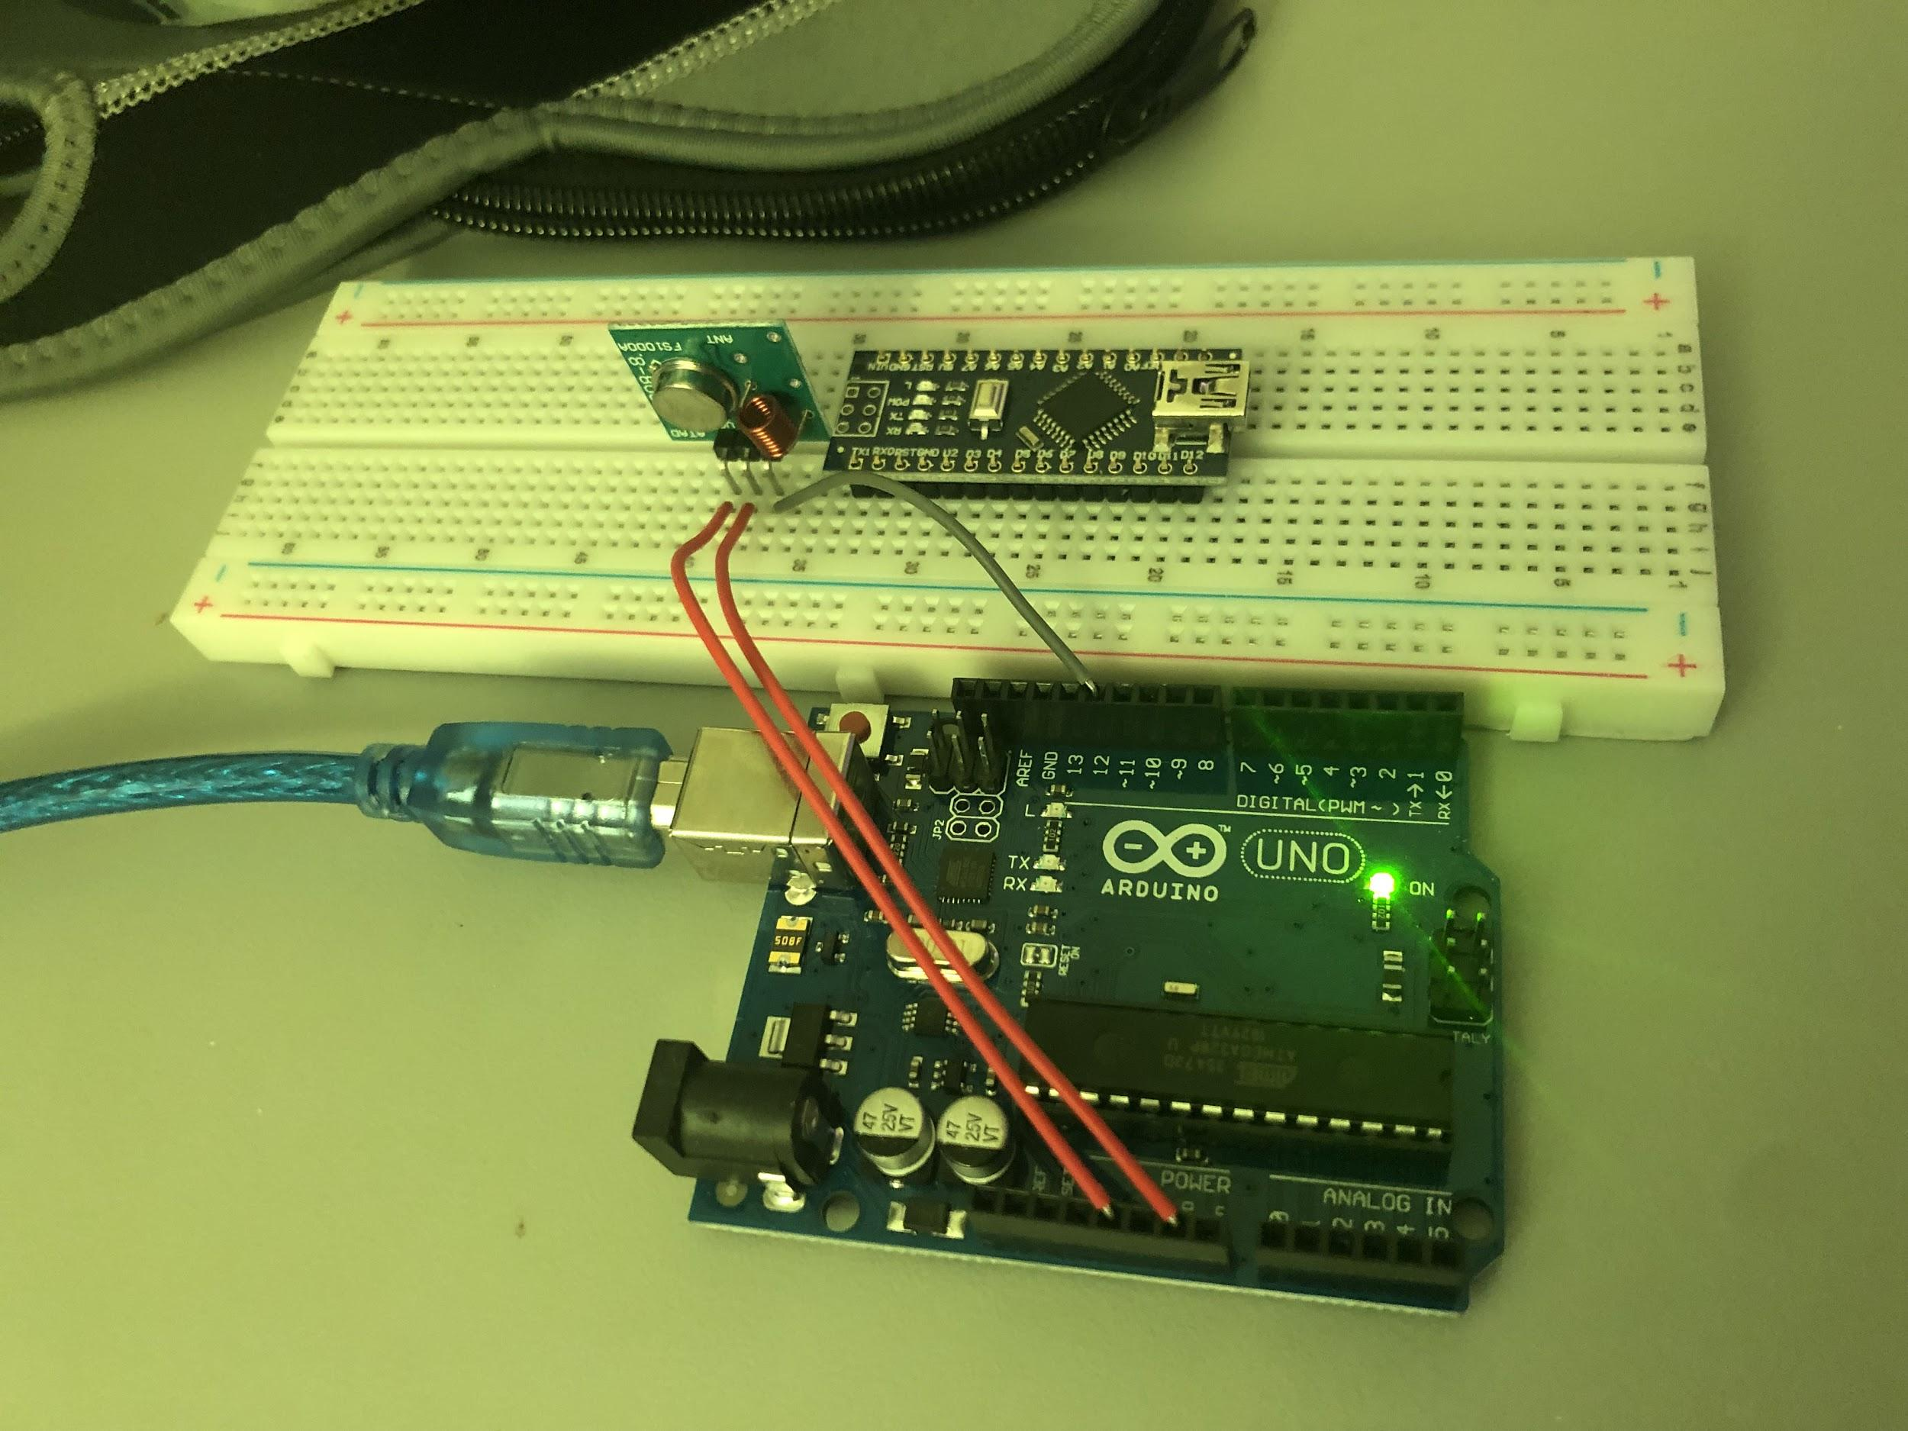
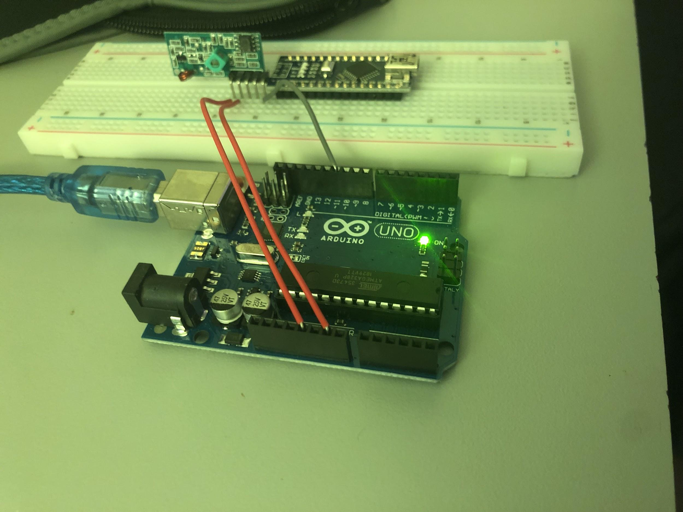
Implementation (subtask 2.1-2.4) Design of the Arduino RF transmitter and RF Receiver interface.

Slide 37
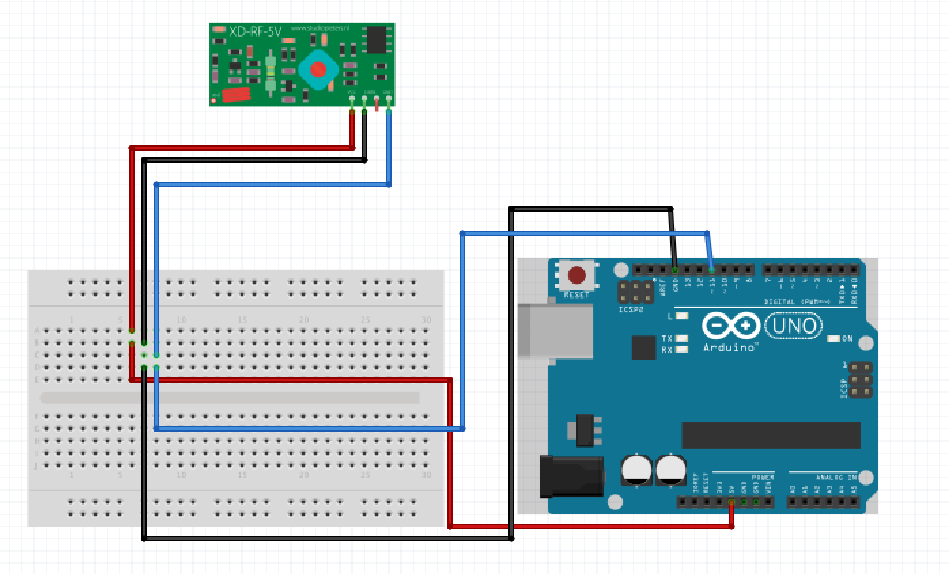
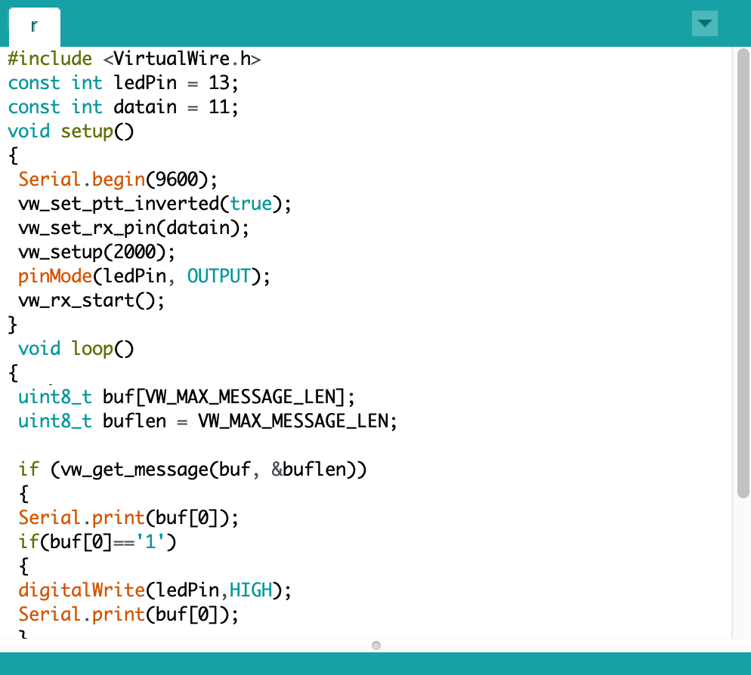
Implementation (subtask 2.3-2.4) Design of arduino and RF receiver interface.

Slide 38
Implementation (Subtask 2.3-2.4) Design of arduino and RF receiver interface video.

Slide 39
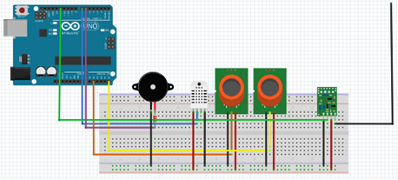
Implementation (Subtask 2.5) transmitter breadboard schematic.

Slide 40
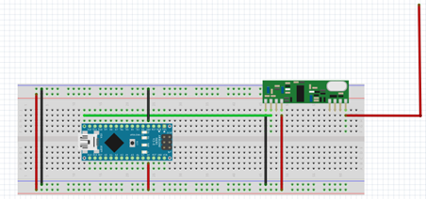
Implementation (Subtask 2.5) receiver breadboard schematic.

Slide 41
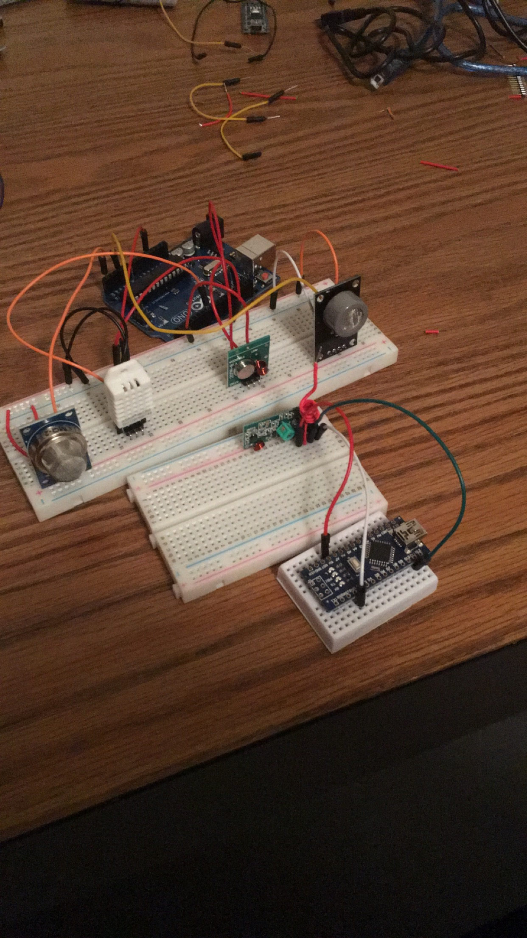
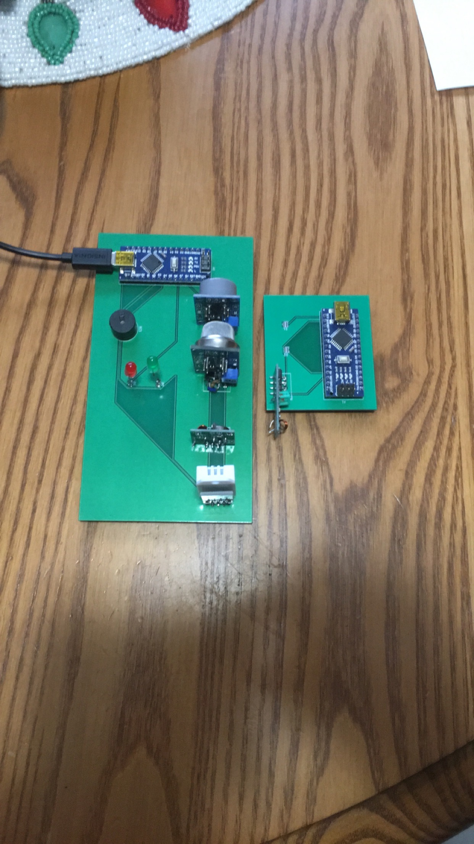
Implementation (Subtask 2.5) configure all sensors with RF receiver and transmitter.

Slide 42


Implementation (Subtask 2.5) transmitter code for Arduino and RF transmitter.

Slide 43


Implementation (Subtask 2.5) receiver code for Arduino and RF transmitter.

Slide 44

Implementation (Subtask 2.5) receiver code continued.

Slide 45

Implementation (Subtask 2.5) receiver code
Initializes pin number for RF input from 433 mHz receiver.
Sets data input rate at 2000 bps (bytes per second).

Slide 46

Implementation (Subtask 2.5) receiver code for Arduino and RF Receiver video.

Slide 47


Implementation (Subtask 2.6) raspberry pi and receiver breadboard schematic.

Slide 48

Implementation (Subtask 2.7) configure Raspberry Pi to receive node data

Slide 49

Implementation subtask (2.8-2.9) Configure raspberry pi and website for node data processing and storage continued.

Slide 50
Implementation (Subtask 2.8-2.9) design program to interpret node data and send data to webpage

Slide 51

Implementation (Subtask 2.10) Design voice alarm notification for each node.
This is the terminal output for espeak.
Espeak is not a python program.
Has to be imported from Linux.

Slide 52


Implementation (Subtask 2.10) Design voice alarm notification for each node.

Slide 53


Implementation (Subtask 2.10 continued) Design voice alarm notification for each node.

Slide 54
Implementation (Subtask 2.10 continued) Design voice alarm notification for each node.

Slide 55
Implementation (Subtask 2.10 continued) Design voice alarm notification for each node.

Slide 56

Implementation (subtask 3.1) Index for webpage

Slide 57


Implementation (subtask 3.1) css for webpage

Slide 58

Implementation (3.2) Registration page

Slide 59


Implementation (3.2) Javascript for registration/login page

Slide 60

Implementation (3.2) Connection to heroku database

Slide 61

Implementation (3.2) Registration Database

Slide 62

Implementation (3.3) User Selection

Slide 63

Implementation (3.4) Connecting Raspberry Pi to Website

Slide 64

Implementation (Subtask 4.1) Send WSN data to webpage

Slide 65

Implementation (Subtask 4.1) Send WSN data to webpage

Slide 66
Implementation (Subtask 4.1) Send WSN data to webpage

Slide 67

Implementation (Subtask 4.3) Admin Layout Upload

Slide 68


Implementation (Subtask 4.4) Configuration of Node IDs with Website

Slide 69

Implementation (Subtask 4.5) Program alarm shut off for administrative use.

Slide 70

Implementation (Subtask 4.6) Display Motion Detection on the webpage

Slide 71

Implementation (subtask 5.1) Setup Twilio account and install corresponding software on the Raspberry Pi.

Slide 72

Implementation (subtask 5.1) Setup Twilio account and install corresponding software on the Raspberry Pi.

Slide 73


Implementation (subtask 5.2) Configure Twilio with wireless sensor network.

Slide 74


Implementation (Subtask 5.3) Design program that will allocate node ID for a specific automated dispatch message.

Slide 75

Implementation (subtask 5.4) Design program that will allocate node ID numbers to specific automated dispatch message (local).

Slide 76

Implementation of (subtask 5.5) Program each specific node ID for a specific SMS message transmission and voice call.

Slide 77


Implementation (Subtask 6.1) Design a local database for building occupant phone number storage.

Slide 78

Implementation (Subtask 6.1) Design a local database for building occupant phone number storage.

Slide 79

Implementation (Subtask 6.1) Design a local database for building occupant phone number storage.

Slide 80


Implementation (Subtask 6.2-6.3) Design and Configuration of warning message database with building occupant phone number database.

Slide 81


Implementation (Subtask 6.2-6.3) Design and Configuration of warning message database with building occupant phone number database.

Slide 82


Implementation (Subtask 7.1-7.3) Design of 3D printed housings for transmitters and receiver.

Slide 83



Implementation (Subtask 7.1-7.3) Design of 3D printed housings for transmitters and receiver.

Slide 84


Implementation (subtask 8.1) Complete System Assembly.

Slide 85
Implementation (subtask 8.1-8.2) Complete System Testing.

